Slide 1
OBJECT ORIENTED PROGRAMMING
(ICT 2155)

Slide 2
Course Outcome :
CO1 : Develop simple applications using JAVA. (data types, operators, arrays)
CO2 : Understand how object oriented concepts can be implemented using JAVA
CO3 : Use inbuilt library packages of JAVA
CO4 : Develop java applications using object oriented concepts.
CO5 : Write simple concurrent programs using threads.

Slide 3
Introduction
The birth of modern programming language C, the need for C++, Java, Importance of Java in the internet, security, portability, the byte code. An overview of Java, OOP, Two paradigms, abstraction, the three OOP Principles.
Data Types, Variable and Arrays
Simple types, integers, floating point types, characters, Booleans, variables – declaring variable, dynamic initialization, the scope and life time of variables, type conversion and casting, arrays-one dimensional arrays and multi-dimensional arrays.

Slide 4
Operators and control statements
Arithmetic operators, bitwise operators, relational operators, logical operators, assignment operators, ternary operators, operator precedence. Control statements – if, switch, while, do-while, for nested loops, break, continue.
Classes and Inheritance
Class fundamentals, declaring objects, assigning object references variables, introducing methods, constructors, overloading method, using objects as parameters, argument passing, returning objects, recursion, use of static and final key word, nested and inner class, using command line arguments. Inheritance – basics, using super, creating a multi-level hierarchy, when constructor are called, method overriding, dynamic method dispatch, using abstract classes, using final with inheritance, Wrapper classes.

Slide 5
Packages and Interfaces
Packages, defining a package, use of CLASSPATH, package example, access protection, importing packages, Interfaces – defining an interface, implementing interfaces, applying interfaces, variables in interfaces, extending interfaces.
Array list and Vectors
The list interface, Array list class, obtaining an array from an array list, Vector.
String Handling
String constructors, string length, special operations, character extraction, string comparison, searching strings, modifying a string, string buffer, string tokenizer.

Slide 6
Exception Handling
Fundamentals, exception types, uncaught exception, using try and catch, multiple catch clauses, nested try statements, throw, throws, finally, Java‟s built in exception, creating exception subclasses, using exception.
Thread Concepts
The java thread model, thread priorities, synchronization, thread class and runnable interface, the main thread, creating a thread, creating multiple threads, using is Alive and join, inter thread communication.

Slide 7
Input/Output
Java I/O classes and Interfaces, File – directories, using filename filter, the stream classes, the byte streams-input stream, output stream, file input stream, file output stream, byte array input stream, byte array output stream, random access files. The character streams- Reader, Writer, FileReader, FileWriter, BufferedReader, BufferedWriter. Serialization, Serializable, Object Output, Object Output Stream, Object Input, Object Input Stream.
Swings
Swing fundamentals. Writing swing application, Swing library, layouts and controls. Introduction to event handling

Slide 8
References :
Herbert Schildt, Java The Complete Reference (9e), Tata McGrawHill 2014.
Cay S. Horstmann & Gary Cornell, Core Java Volume I – Fundamentals (9e), Prentice Hall 2013.
Cay S. Horstmann & Gary Cornell, Core Java Volume II – Advanced Features (9e), Prentice Hall 2013.

Slide 9
JAVA
Java was designed by Sun Microsystems.
First release in January 1996.
Developed by James Gosling.
For controlling simple home devices with embedding microcomputers.
Used to create desk top applications and web applications.

Slide 10
Java Features
Simple
Secure
Portable
Object-oriented
Robust
Multithreaded
Architecture-neutral
Interpreted
Distributed
Dynamic

Slide 11
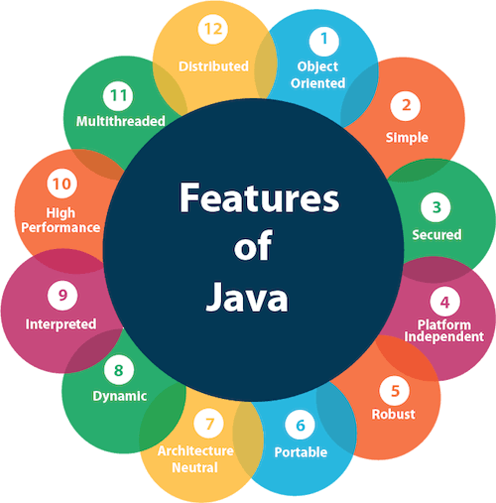

Slide 12
Simple:
Java is simple because: it doesn’t use complex and difficult features of other languages like C and C++, which are as follows:
Concept of Explicit Pointers
Storage classes
Preprocessors and header files
Multiple Inheritance
Operator Overloading
Goto Statements
Java’ Automatic Garbage Collection, in which there is no need to remove the unreferenced objects explicitly

Slide 13
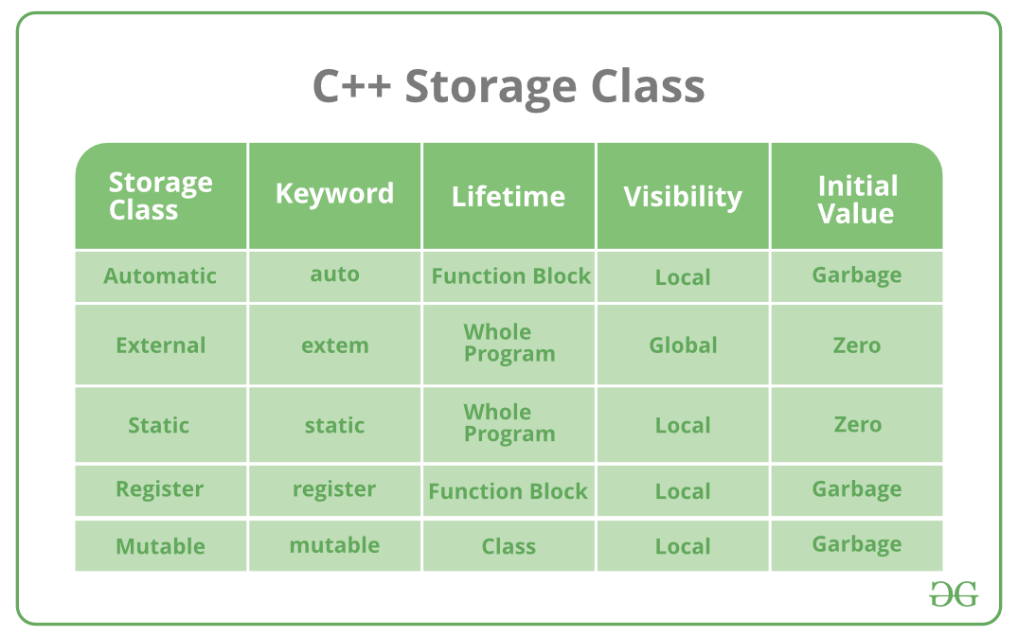
Storage Class : To define scope, visibility and life-time which help us to trace the existence of a particular variable during the runtime of a program
Syntax: storage_class var_data_type var_name;

Slide 14
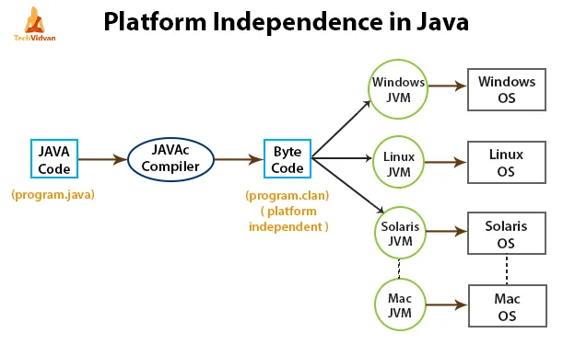

Slide 15
Java Virtual Machine (JVM )
The Java virtual machine (JVM) is a software implementation of a computer.
JVM executes programs like a real machine.
The JVM is written specifically for a specific operating system.
Java programs are compiled by the Java compiler into bytecode.
The JVM interprets this bytecode and executes the Java program.

Slide 16
Portable:
In Java, the size of the primitive data types is machine-independent, which were dependent in the case of C/C++.
So, these provisions make Java programs portable among different platforms such as Windows, Unix, Solaris, and Mac.
Architectural Neutral:
‘Write-once-run-anywhere’ (WORA) or ‘Write-once-run-everywhere’ (WORE) approach
Byte-code is not dependent on any machine architecture and Java Virtual Machine (JVM) can easily translate bytecode into a machine-specific code
This feature is very useful when we develop applets or download applications from the Internet.

Slide 17
Object-Oriented:
Java strongly supports the concepts of Object-Oriented Programming due to which it is called a pure object-oriented language.
All programs and data live within objects and classes.
Robust:
Java is capable of handling run-time errors: exception
supports automatic garbage collection: JVM automatically deallocates the memory blocks
Avoids explicit pointer concept

Slide 18
Secure:
Java supports access modifiers : to access the variable, methods, and constructors
Also ensures that no viruses enter an applet
Programs run in a virtual machine sandbox – A separate environment that allows users to execute their applications without affecting the underlying system.
It has a bytecode verifier that checks the code fragments for any illegal code that violates the access right.

Slide 19
Distributed:
Supports to create distributed applications
(which is very helpful when we develop large projects.)
In Java, we can split a program into many parts and store these parts on different computers.
Java helps us to achieve this by providing the concept of RMI (Remote Method Invocation) and EJB (Enterprise JavaBeans)
Java comes with an extensive library of classes for interacting, using TCP/IP protocols such as HTTP and FTP

Slide 20
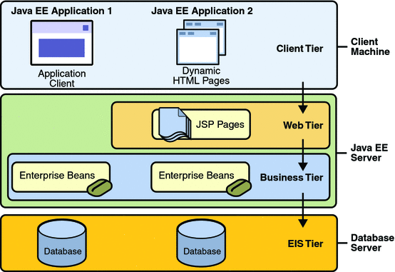
Distributed Multitiered Applications

Slide 21
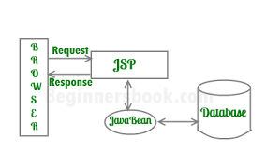
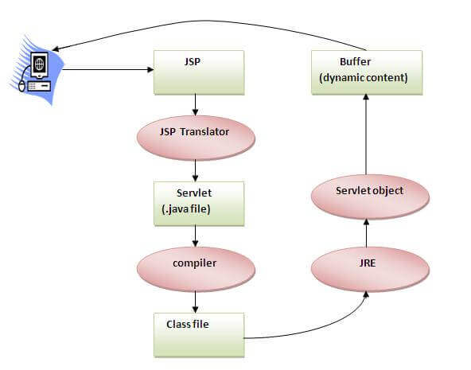
JSP and JAVA Bean

Slide 22
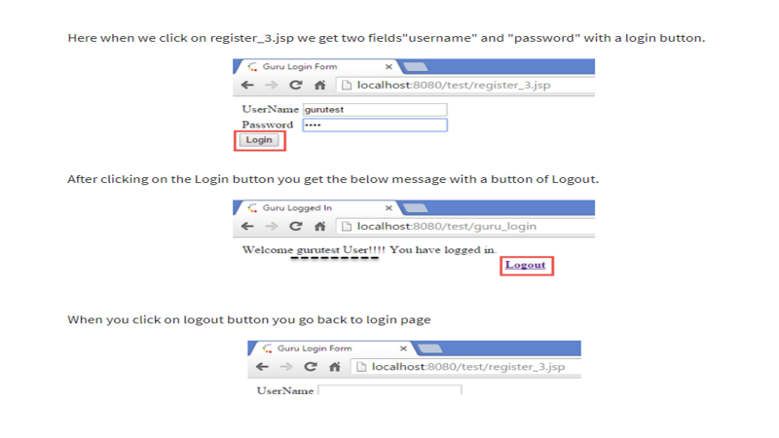

Slide 23
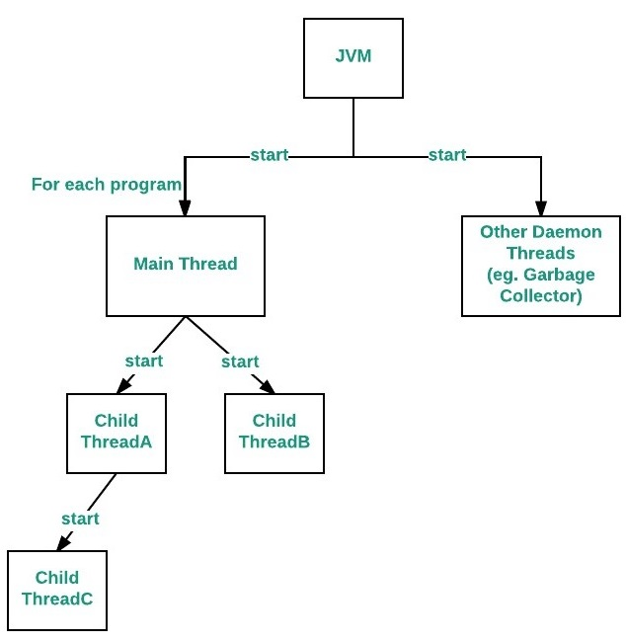
Multi-threaded and Interactive:
Multithreaded means handling multiple tasks simultaneously or executing multiple portions (functions) of the same program in parallel.

Slide 24
Advantages:
The main advantage of multithreading is that the maximum utilization of resources is possible.
It doesn’t occupy memory for each thread. It shares a common memory area.
There is no need to wait for the application to finish one task before beginning another one.
There is a decreased cost of maintenance. Also, It is time-saving.
It improves the performance of complex applications.

Slide 25
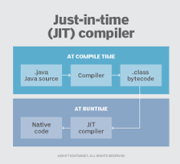
High Performance:
Java provides high performance with the use of “JIT – Just In Time compiler”, in which the compiler compiles the code on-demand basis, that is, it compiles only that method which is being called. This saves time and makes it more efficient.
The Just-In-Time (JIT) compiler is a component of the runtime environment that improves the performance of Java applications by compiling bytecodes to native machine code at run time.

Slide 26
High Performance: multithreading enhances the overall execution speed of Java programs
Bytecodes generated by the Java compiler are highly optimized, so Java Virtual Machine can execute them much faster.

Slide 27
Dynamic and Extensible:
with the help of OOPs, we can add classes and add new methods to classes, creating new classes through subclasses. This makes it easier for us to expand our own classes and even modify them.
Java gives the facility of dynamically linking new class libraries, methods, and objects.
Java even supports functions written in other languages such as C and C++ to be written in Java programs. These functions are called “native methods”. These methods are dynamically linked at runtime.

Slide 28
Simple
Looks familiar to existing programmers: related to C and C++
Omits rarely used, features of C++, like operator overloading, multiple inheritance etc.
Contains no goto statement, but break and continue
has no pointers
A rich predefined class library

Slide 29
Secure
No memory pointers
Programs runs inside the virtual machine sandbox.
Array index limit checking
Automatic memory management – GC

Slide 30
Portable
  Java compiler generates bytecodes
  Runtime systems for various platforms
  Size and behavior of basic data types defined
  Write once, run anywhere

Slide 31
Object Oriented
Focus on the data in our application and methods that manipulate that data.
The data and methods describe the state and behavior of an object.
Classes are arranged in a hierarchy, a subclass can inherit behavior from its superclass.
Has extensive set of classes, arranged in packages.

Slide 32
Robust
Memory Management
Exception Handling

Slide 33
Multithreaded
Supports multithreaded programming, which allows to write programs that do many things simultaneously

Slide 34
Architectural neutral
Write once- run anywhere

Slide 35
Interpreted
Enables the creation of cross-platform programs by compiling into an intermediate representation called Java bytecode .
This code can be interpreted on any system that provides a Java Virtual Machine.

Slide 36
Distributed
Java has extensive TCP/IP networking capabilities.
Has a feature called Remote Method Invocation (RMI).
Library routines for HTTP, FTP exist.
Accessing a resource using a URL is not much different from accessing a file.

Slide 37
Dynamic
Supports dynamic loading of classes.

Slide 38
Java and C
Java dose not include keywords goto, sizeof and typedef.
Java dose not contain the datatypes struct, union and enum.
Java does not define the type modifiers auto, extern, register, signed and unsigned.
Java does not support explicit pointer types.
Java does not have a preprocessor and therefore we can not use #define, #include.
Java adds new operator such as instanceof and >>>
Java adds labeled break and continue statements

Slide 39
Java and C++
Java adds many features required for object oriented programming
Java does not support operator overloading.
Java does not support multiple inheritance. Has a new feature called “interface”.
Java has replaced the destructor function with a finalize function.
Java does not use pointers.

Slide 40
Example 1
class Example
{
public static void main(String args[] )
{
System.out.println (“Hello World");
}
}
Note : String, System
class name is same as file name with the extension .java

Slide 41
main must be declared as public since it must be called by code outside of class when the program is started.
The keyword static allows main() to be called without having to instantiating a particular instance of the class
main is called by the Java Virtual Machine before any objects are made.

Slide 42
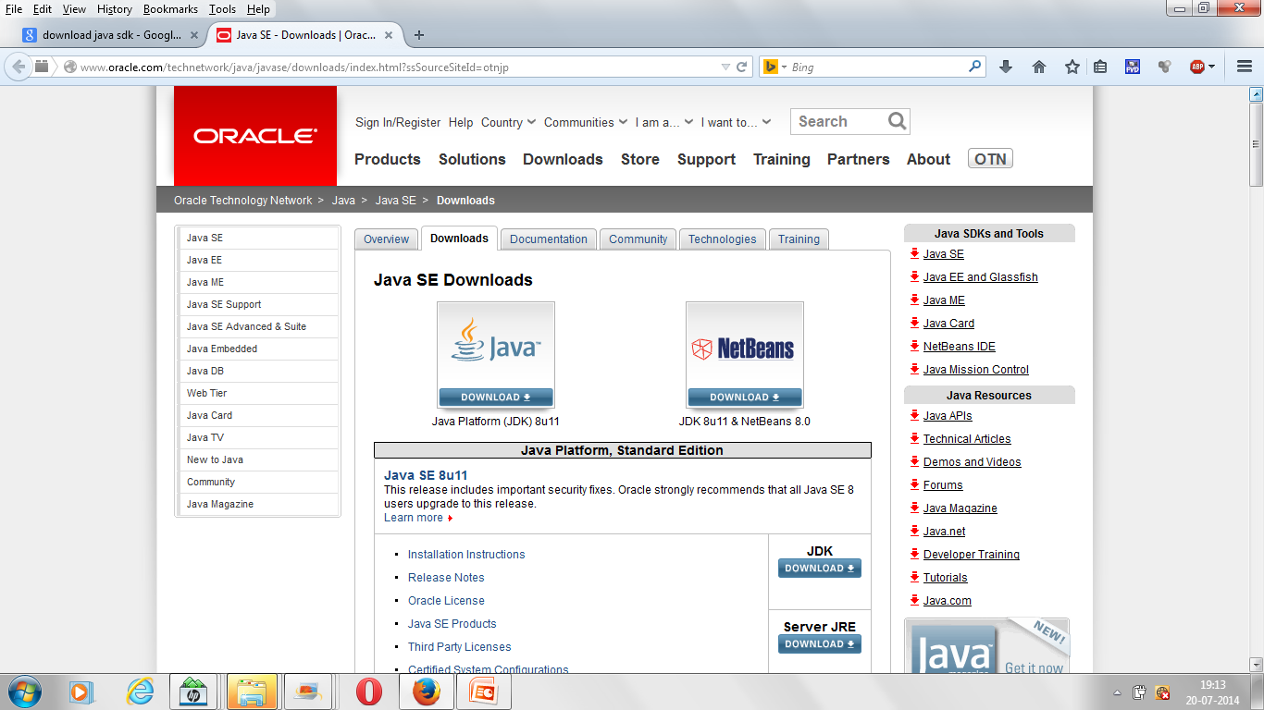
Downloading and installing JDK

Slide 43
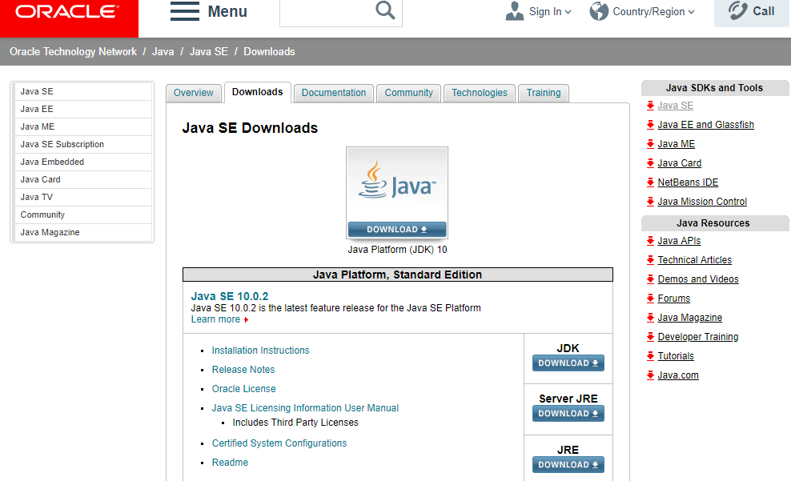
Downloading and installing JDK

Slide 44
Compiling & Executing Java Program
C:\ >jdk1.8\bin\ edit Example.java
C:\ >jdk1.8\bin\ javac Example.java
C:\ > jdk1.8\bin\ java Example
Hello World

Slide 45
How to set Path in Java
The path is required to be set for using tools such as javac, java etc.
If you are saving the java source file inside the jdk/bin directory, path is not required to be set because all the tools will be available in the current directory.
But If you are having your java file outside the jdk/bin folder, it is necessary to set path of JDK.
There are 2 ways to set java path:
Temporary
Permanent

Slide 46
For setting the permanent path of JDK, you need to follow these steps:
Go to MyComputer properties -> Advanced tab -> Environment variables -> new tab of user variable -> write path in variable name -> write path of bin folder in variable value -> ok -> ok -> ok

Slide 47
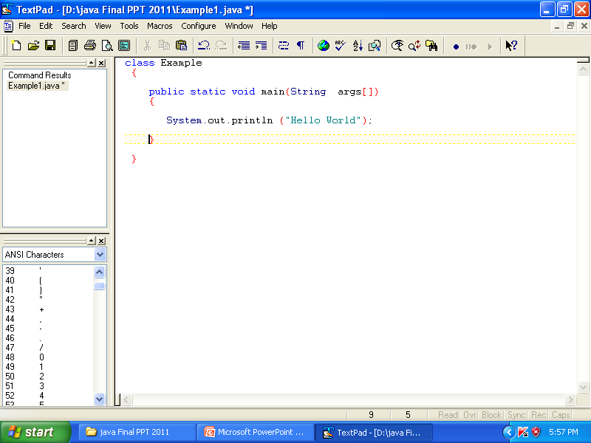

Slide 48
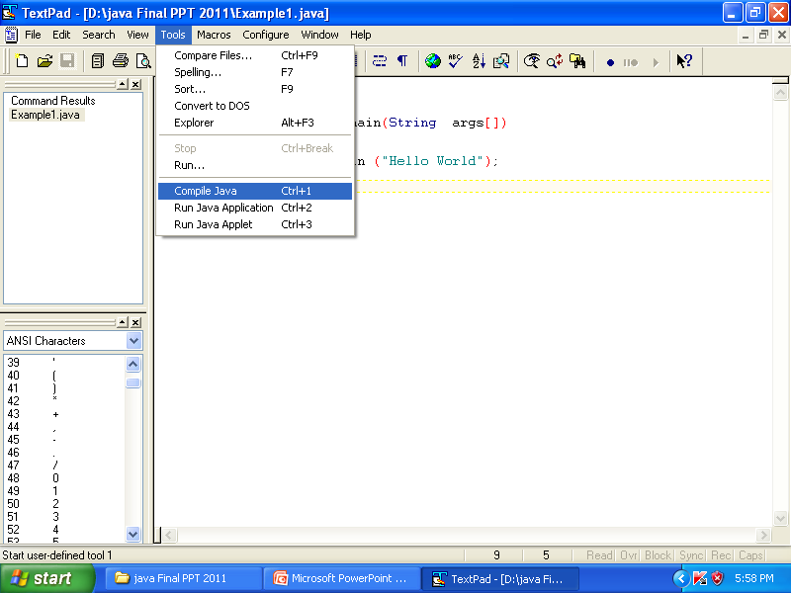

Slide 49
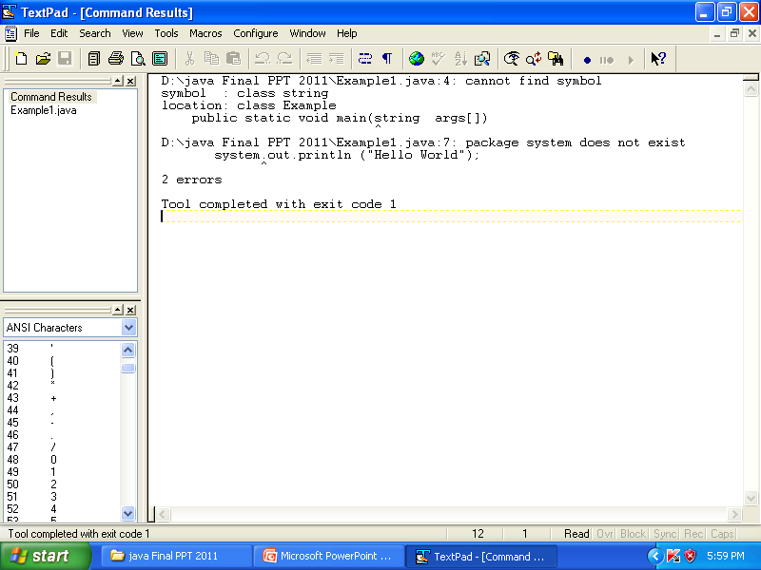

Slide 50
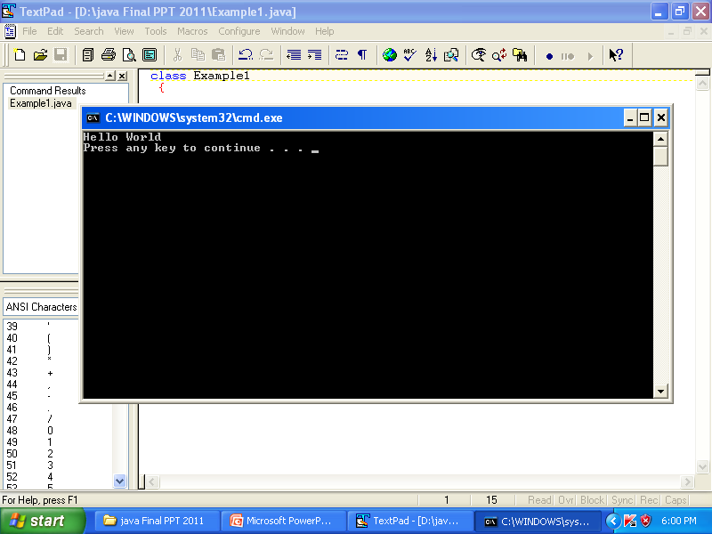

Slide 51
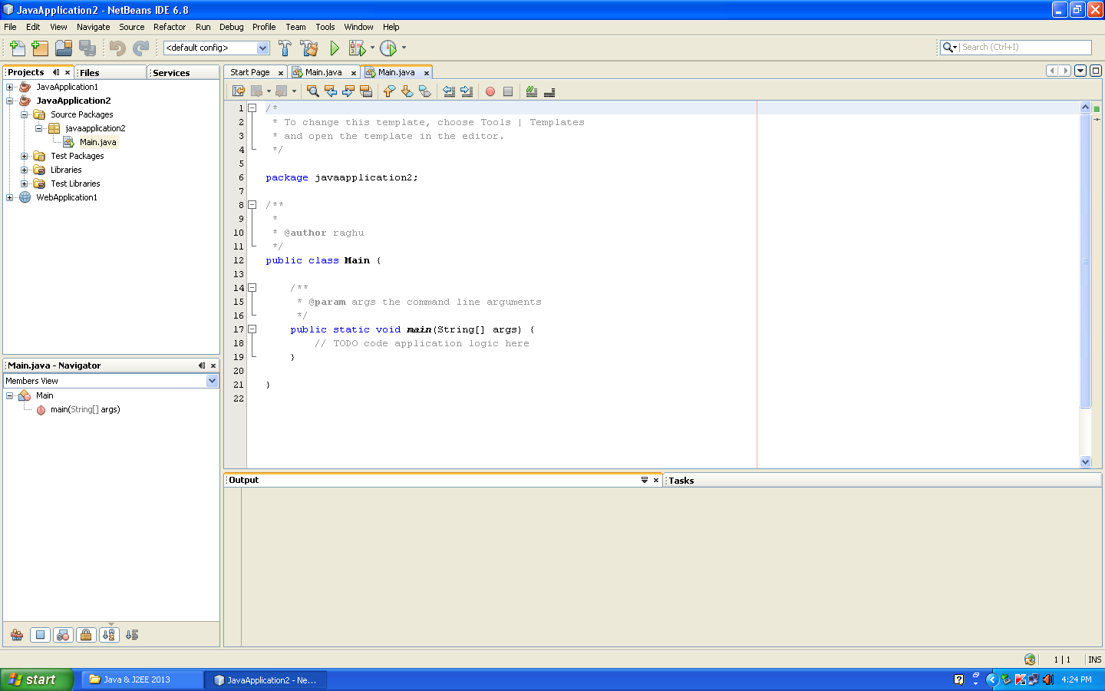

Slide 52
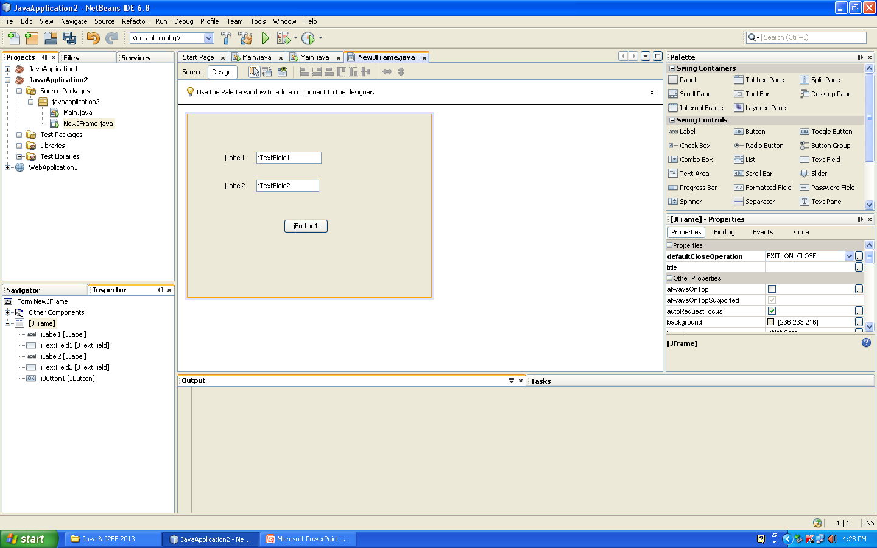

Slide 53
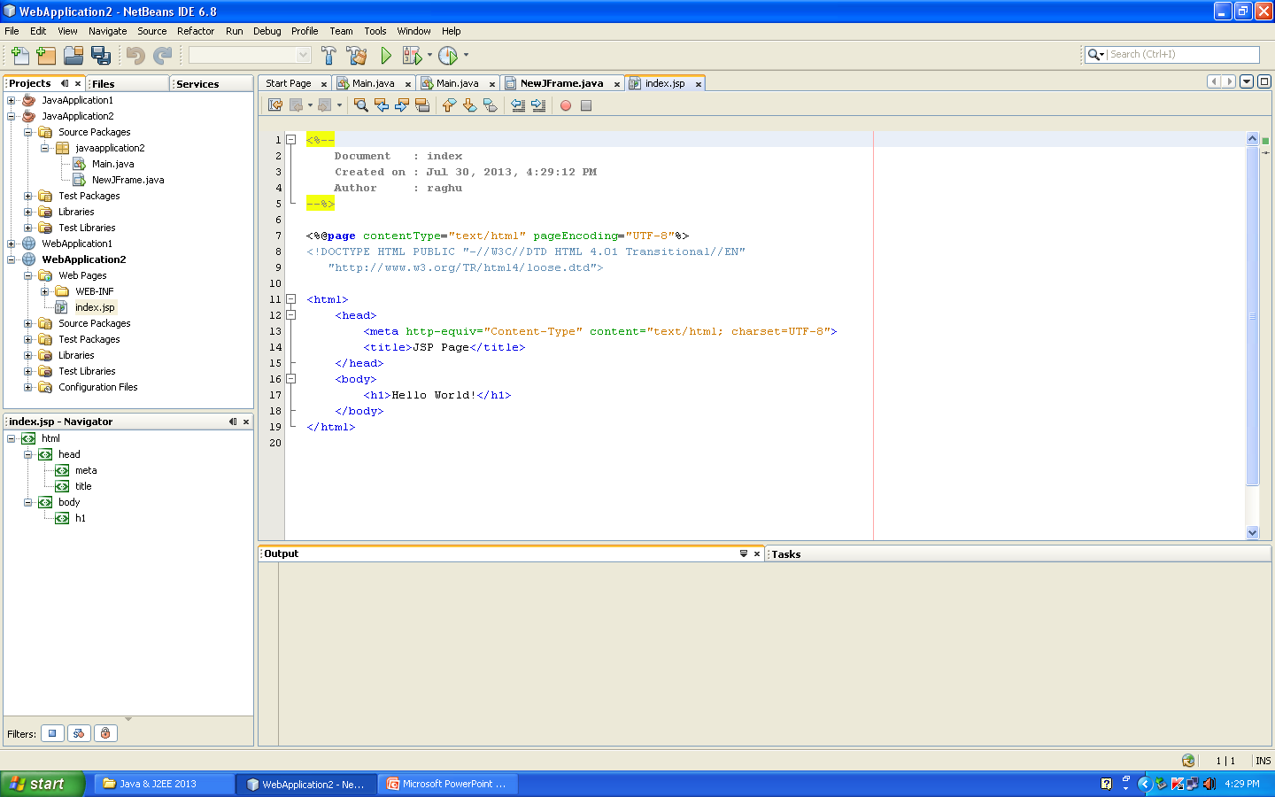

Slide 54
Example2 : Variable Declaration
class Example2
{ public static void main(String args[])
{ int a,b,c;
a=2;
b=3;
c = a+b;
System.out.println(c);
System.out.println(“sum is”+c);
System.out.println(“sum of”+a+”and”+b is”+c);
}
}
OUTPUT : 5
sum is 5
Sum of 2 and 3 is 5

Slide 55
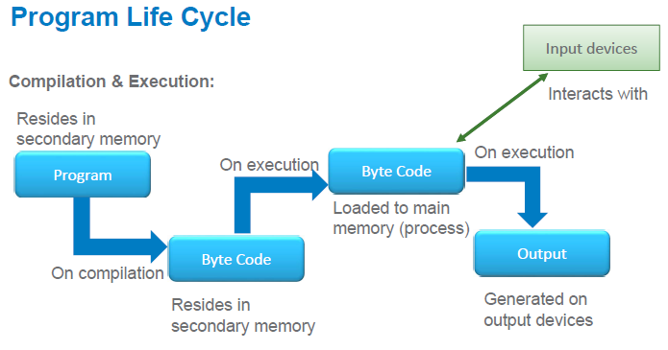

Slide 56
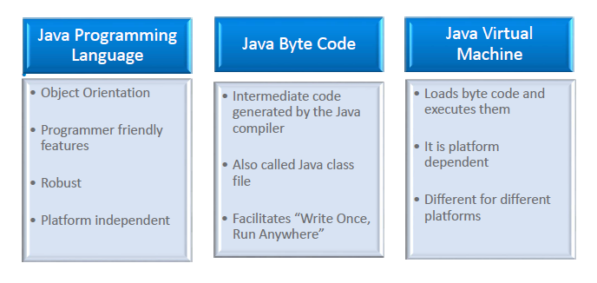

Slide 57
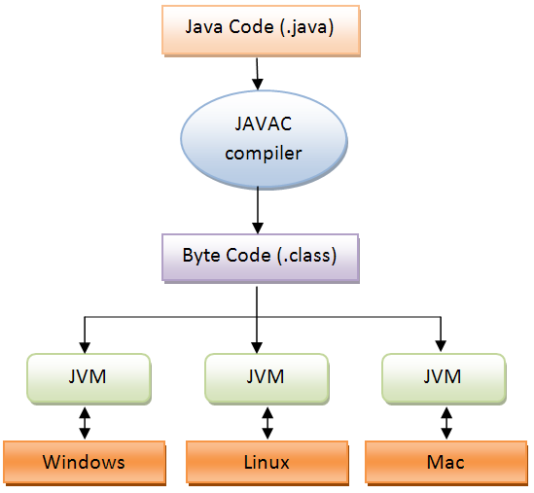
Java Virtual Machine (JVM )

Slide 58
Java Development Kit (JDK): Includes (JRE), an interpreter/loader (Java), a compiler (javac), an archiver (jar), a documentation generator (Javadoc), and other tools needed in Java development
Java Runtime Environment (JRE): The Java Runtime Environment (JRE) is software that Java programs require to run correctly.
Java Virtual Machine (JVM)
Jdk = jre + development tools
Jre = jvm + library classes

Slide 59
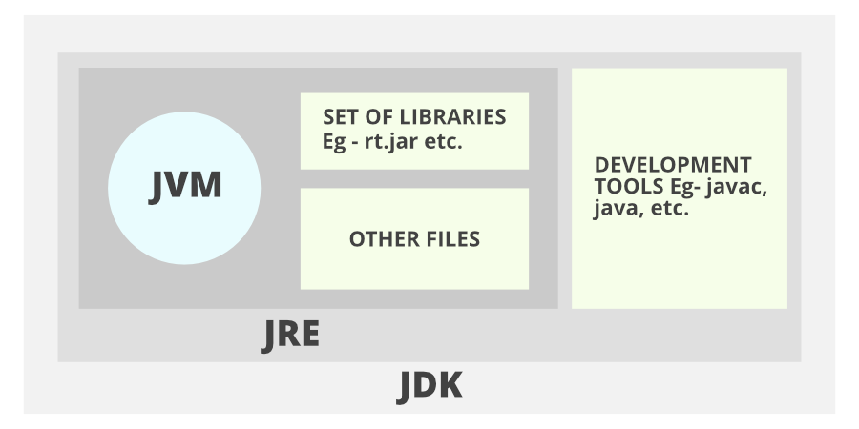
Notes:
JAR stands for Java ARchive. It's a file format based on the popular ZIP file format and is used for aggregating many files into one.

Slide 60
Java Language
A1.java
RAM
main()
{
f1()
f2()
}
JVM
Class loader
Byte code verifier
A1.class
A1.class
A2.java
A2.class
Execution engine
Garbage collector
f1()
{
}
compiler
A2.class
A3.class
A3.class
A3.java
f2()
{
}
when java command is executed an instance of JVM is created.
The class loader is responsible for bringing the class file into the JVM

Slide 61
Object-Oriented Programming
All computer programs consist of two elements: Task and data.
Program can be conceptually organized around its code/task or around its data.
These are the two paradigms that govern how a program is constructed.
  process-oriented.
  Object Oriented

Slide 62
Process-oriented programming.
This approach characterizes a program as a series of linear steps (that is, code).
The process-oriented model can be thought of as code acting on data.
Problems with this approach appear as programs grow larger and more complex.
Object-oriented programming
Object-oriented programming organizes a program around its data (that is, objects) and a set of well-defined interfaces to that data.
An object-oriented program can be characterized as data controlling access to code.

Slide 63
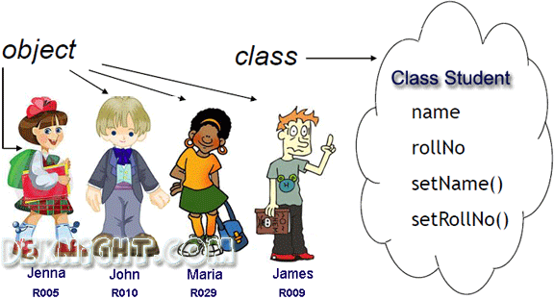
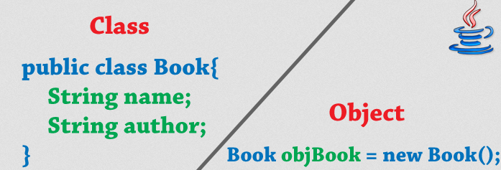
Class and Objects

Slide 64
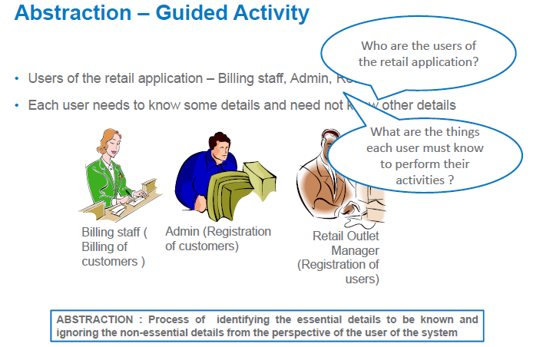

Slide 65
Data Abstraction
The act of representing essential features without including the background details or explanations.

Slide 66
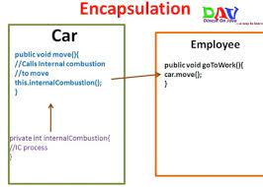
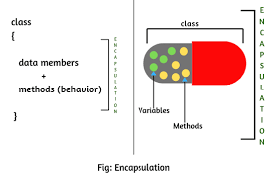
Encapsulation:
In Object Oriented Programming, Encapsulation is defined as binding together the data and the functions that manipulate them.

Slide 67
Encapsulation
Wrapping up of data and methods into a single unit (called class).
The data is not accessible to the outside world and only those methods, which are wrapped in the class, can access it.
These methods provide the interface between the object's data and the program.
This insulation of the data from direct access by 'the program is called datahiding.
Encapsulation makes it possible for objects to be treated like 'black boxes‘.

Slide 68
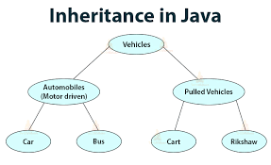
Inheritence

Slide 69
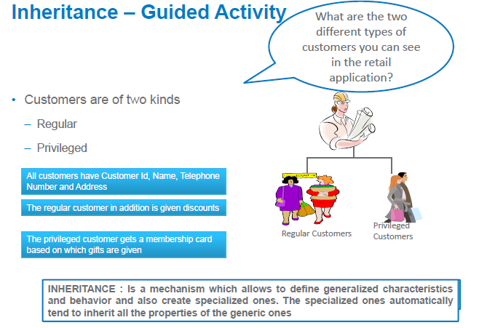

Slide 70
Inheritance
Inheritance provides the idea of reusability: This means that we can add additional features to an existing class without modifying it.
This is possible by deriving a new class from the existing one.
The new class will have the combined features of both the classes.
Subclass defines only those features that are unique to it.
Without the use of inheritance, each class would have to explicitly include all of its features.

Slide 71
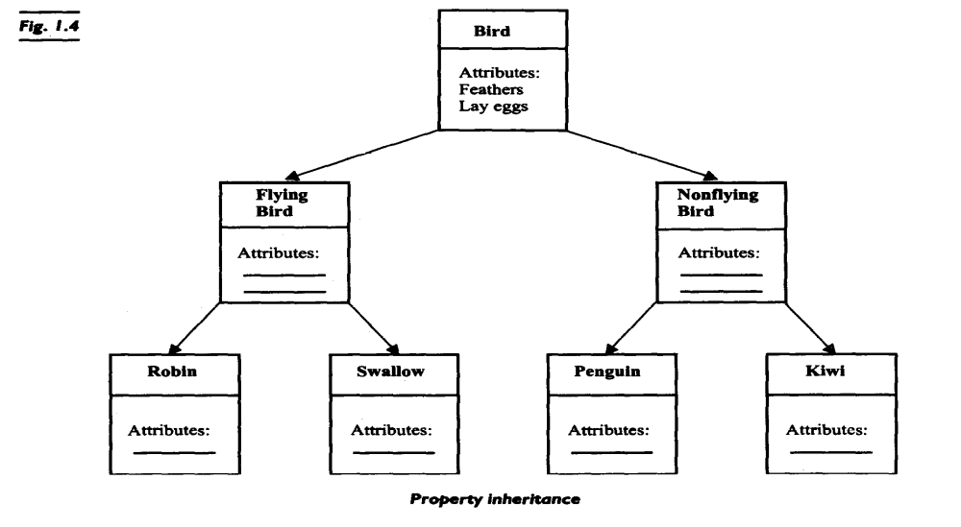
Inheritance

Slide 72
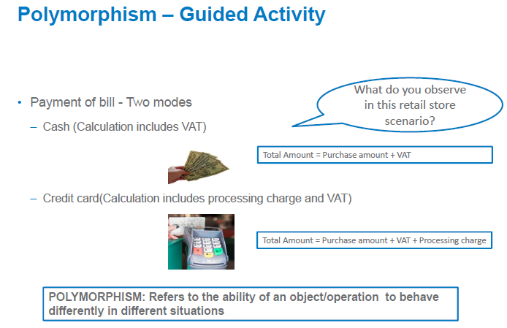

Slide 73
Polymorphism
Polymorphism means the ability to take more than one form.
For example, an operation may exhibit different behavior in different instances.
The behavior depends upon the types of data used in the operation.
For example, consider the operation of addition.
For two numbers, the operation will generate a sum. If the operands are strings, then the operation would produce a third string by concatenation.

Slide 74
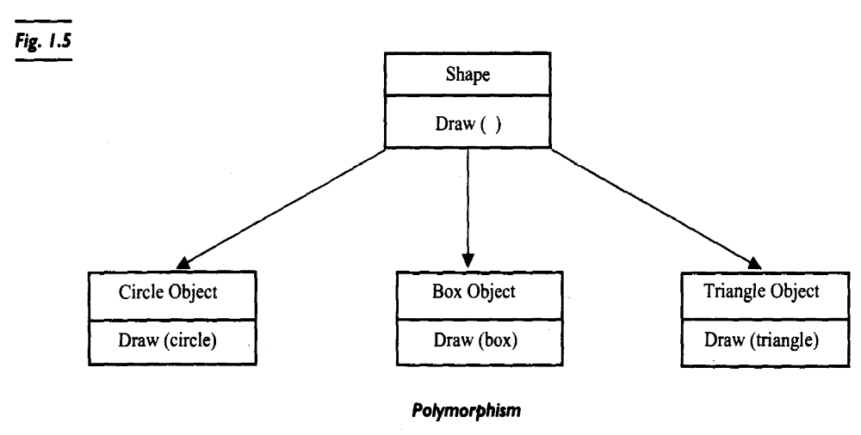
Polymorphism

Slide 75
Object Oriented Approach - Benefits
Through inheritance, we can eliminate redundant code and extend the use of existing classes .
We can build programs from the standard working modules that communicate with one another, rather than having to start writing the code from scratch.
Principle of data hiding helps the programmer to build secure programs.
Reduces the rick factor in building large systems as they are built incrementally from subsystems which are stable.

Slide 76
Basic terms
Java programs are a collection of whitespace, identifiers, comments, literals, operators, separators, and keywords.
whitespace
identifiers
comments
literals
operators
separators
keyworlds

Slide 77
whitespace
Java is a free form language.

Slide 78
identifiers
An identifier may be any descriptive sequence of uppercase and lowercase letters,
numbers or the underscore and dollar-sign characters.
valid identifiers : AvgTemp count a4 $test this_ is _ ok
Invalid identifier: 2count high-temp Not/ok

Slide 79
Literals
A constant value in Java is created by using a literal representation of it.
For example, here are some literals:
100 98.6 ‘X’ “This is a test”

Slide 80
comments
// Java single-line comment
/*other Java comment style*/
/* also can go on
for any number of lines*/

Slide 81
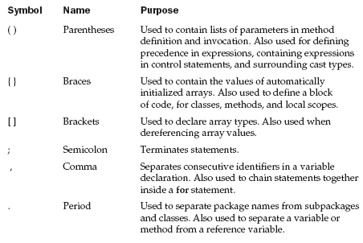
separators

Slide 82
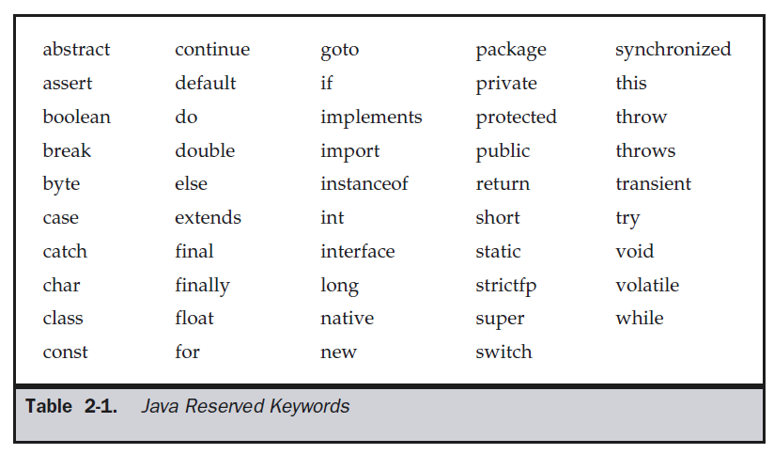
keywords

Slide 83
The Simple Types
Defines eight simple types: byte, short, int, long, char, float, double and boolean.
These can be put in four groups:
Integers : includes byte, short, int, and long, which are for whole valued signed numbers.
Floating-point numbers : includes float and double, which represent numbers with fractional precision.
Characters : char, which represents a character
Boolean : boolean, for representing true/false values.

Slide 84
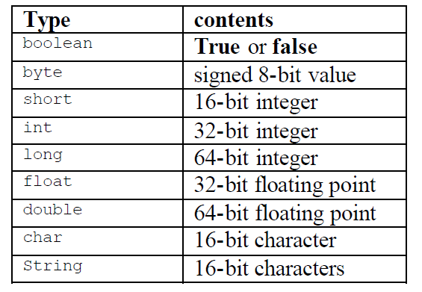

Slide 85
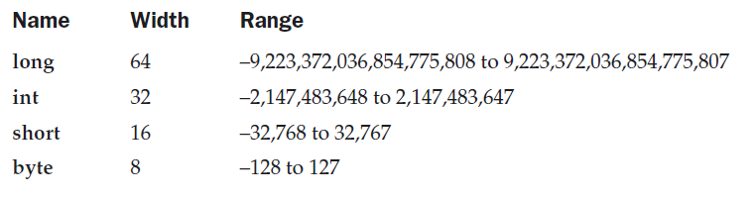
Integer Type

Slide 86
Example
// Compute the area of rectangle
class Light
{ public static void main(String args[])
{
int length, width;
long area;
length = 4;
width =5;
area = length * width;
System.out.println(“ area of rectangle :” + area);
}
}

Slide 87
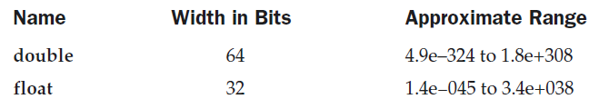
Floating- Point Type

Slide 88
Example
// Compute the area of a circle.
class Area
{
public static void main(String args[])
{
double pi, r, a;
r = 10.8;
pi = 3.1416;
a = pi * r * r;
System.out.println("Area of circle is " + a);
}
}

Slide 89
Character type
// Demonstrate char data type.
class CharDemo
{
public static void main(String args[])
{
char ch1, ch2;
ch1 = 88; // code for X
ch2 = 'Y';
System.out.print("ch1 and ch2: ");
System.out.println(ch1 + " " + ch2);
}
}

Slide 90
// char variables behave like integers.
class CharDemo2
{
public static void main(String args[])
{
char ch1;
ch1 = 'X';
System.out.println("ch1 contains " + ch1);
ch1++; // increment ch1
System.out.println("ch1 is now " + ch1);
}
}

Slide 91
Boolean
class BoolTest
{ public static void main(String args[])
{ boolean b;
b = false;
System.out.println("b is " + b);
b = true;
System.out.println("b is " + b);
if(b) System.out.println("This is executed.");
b = false;
if(b) System.out.println("This is not executed.");
System.out.println("10 > 9 is " + (10 > 9));
} }

Slide 92
Literals
Integer Literals
Floating point literals
Boolean literals
Character literals
String literals

Slide 93
Integer literals
decimal : example 4, 7, 89
Octal:
denoted by leading zeros
Example: 02 , 07
error : 09
Hexadecimal:
denoted by leading 0x or 0X
The range of a hexadecimal digit is 0 to 15, so A through F (or a through f ) are
substituted for 10 through 15.

Slide 94
Floating- Point Literals
represent decimal values with a fractional component.
expressed in either standard or scientific notation.
Standard notation : consists of a whole number component followed by a decimal point followed by a fractional component.
For example, 2.0, 3.14159, and 0.6667

Slide 95
Floating- Point Literals
Scientific notation : uses a standard-notation, floating-point number plus a suffix that
specifies a power of 10 by which the number is to be multiplied.
The exponent is indicated by an E or e followed by a decimal number, which can be positive or negative.
Examples include 6.022E23, 12346E05

Slide 96
Boolean literals
Boolean literals are simple.
There are only two logical values that a boolean value can have, true and false.
The values of true and false do not convert into any numerical representation.
The true literal in Java does not equal 1, nor does the false literal equal 0.

Slide 97
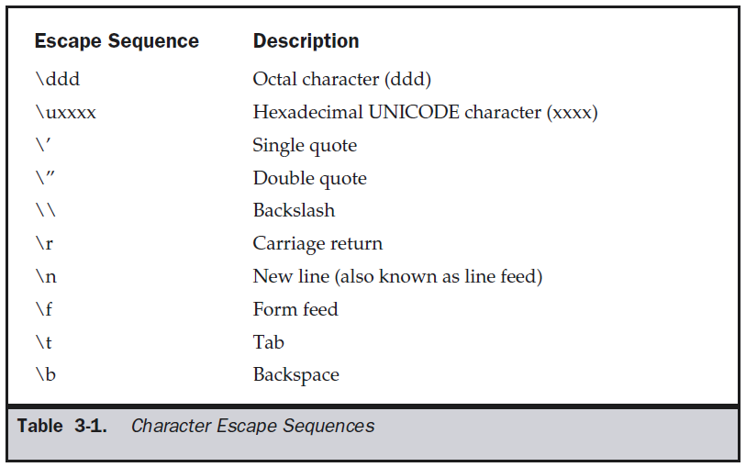
Character Literals

Slide 98
String literals
String literals are specified by enclosing a sequence of characters between a pair of double quotes.
Examples of string literals are
“Hello World”
“two\nlines”
“\”This is in quotes\””

Slide 99
Variables
Declaring a Variable
type identifier [ = value][, identifier [= value] ...] ;
int a, b, c;
int d = 3, e, f = 5;
byte z = 22;
double pi = 3.14159;
char x = 'x';

Slide 100
Dynamic Initialization
// Demonstrate dynamic initialization.
class DynInit
{
public static void main(String args[])
{
double a = 3.0, b = 4.0;
// c is dynamically initialized
double c = Math.sqrt(a * a + b * b);
System.out.println("Hypotenuse is " + c);
}
}

Slide 101
Operators

Slide 102
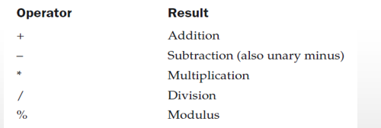
Arithmetic Operators

Slide 103
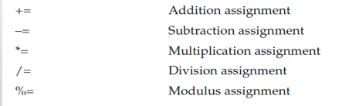
Arithmetic Operators

Slide 104
Arithmetic Operators

Slide 105
Example
// Demonstrate the basic arithmetic operators.
class BasicMath
{ public static void main(String args[])
{ System.out.println("Integer Arithmetic");
int a = 1 + 1;
int b = a * 3;
int c = b / 4;
int d = c - a;
int e = -d;
System.out.println("a = " + a);
System.out.println("b = " + b);
System.out.println("c = " + c);
System.out.println("d = " + d);
System.out.println("e = " + e);
} }

Slide 106
The modules operator
// Demonstrate the % operator.
class Modulus
{ public static void main(String args[])
{
int x = 42;
double y = 42.25;
System.out.println("x mod 10 = " + x % 10);
System.out.println("y mod 10 = " + y % 10);
}
}
output:
x mod 10 = 2
y mod 10 = 2.25

Slide 107
Arithmetic Compound Assignment Operators
class OpEquals
{ public static void main(String args[])
{ int a = 1, b = 2;
int c = 3;
a += 5;
b *= 4;
c += a * b;
c %= 6;
System.out.println("a = " + a);
System.out.println("b = " + b);
System.out.println("c = " + c);
}}

Slide 108
Increment and Decrement
// Demonstrate ++.
class IncDec
{ public static void main(String args[])
{ int a = 1, b = 2;
int c, d;
c = ++b;
d = a++;
c++;
System.out.println("a = " + a);
System.out.println("b = " + b);
System.out.println("c = " + c);
System.out.println("d = " + d);
} }

Slide 109


Relational Operator

Slide 110
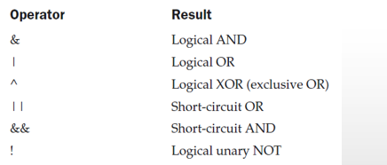
Boolean Logical Operators

Slide 111
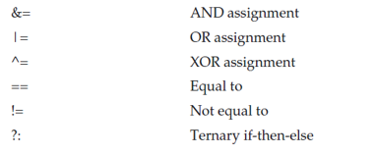
Boolean Logical Operators

Slide 112
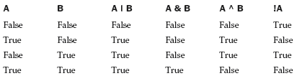

Slide 113
Example
boolean a = true, b = false;
boolean c = a | b;
boolean d = a & b;
boolean e = a ^ b;
boolean f = (!a & b) | (a & !b);
boolean g = !a;
System.out.println(" a = " + a);
System.out.println(" b = " + b);
System.out.println(" a|b = " + c);
System.out.println(" a&b = " + d);
System.out.println(" a^b = " + e);
System.out.println("!a&b|a&!b = " + f);
System.out.println(" !a = " + g);

Slide 114
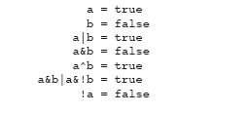

Slide 115
Short-Circuit Logical Operator
if (denom != 0 && num / denom > 10)
if(c==1 & e++ < 100) d = 100;

Slide 116
Short-Circuit Logical Operator
int a=5, b=6;
if(a >1 | ++b > 1)
{
System.out.println("b="+b);
}
int a=5,b=6;
if(a >1 || ++b > 1)
{
System.out.println("b="+b);
}

Slide 117
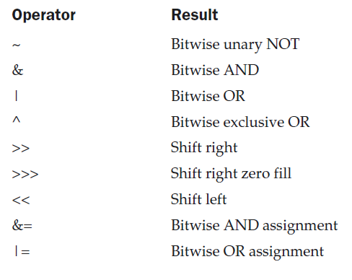
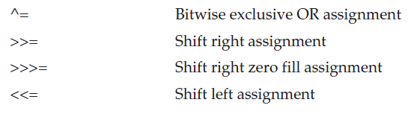
The Bitwise Operators
Bitwise operators can be applied to the integer types, long, int, short, char, and byte.

Slide 118
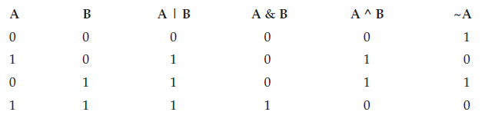
Bitwise logical operator

Slide 119
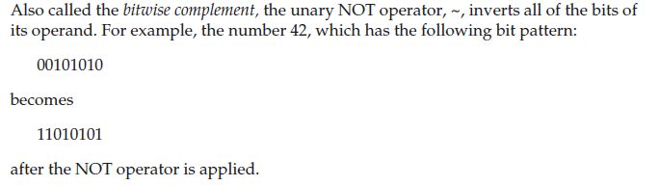
The bitwise Not

Slide 120
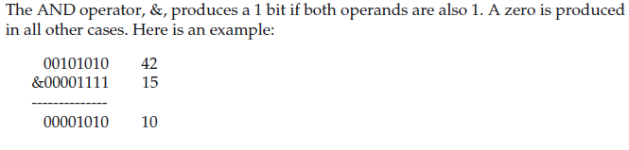
The bitwise AND

Slide 121
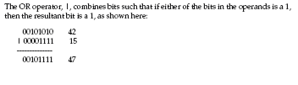
The Bitwise OR

Slide 122

The Bitwise XOR

Slide 123
Example
// Demonstrate the bitwise logical operators.
class BitLogic
{ public static void main(String args[])
{
int a = 3, b = 6;
int c = a | b;
int d = a & b;
int e = a ^ b;
int f = (~a & b) | (a & ~b);
System.out.println(" a = " + a);
System.out.println(" b = " + b);
System.out.println(" a|b = " +c);
System.out.println(" a&b = " + d);
System.out.println(" a^b = " + e);
System.out.println("~a&b|a&~b = " + f);
}
}

Slide 124
Left shift
For each shift left, the high-order bit is shifted out (and lost), and a zero is brought in on the right.
byte a = 8, i;
i = a << 2;
System.out.println("Original value of a: " + a);
System.out.println(i);

Slide 125
The Right shift
When shifting right, the top (leftmost) bits exposed by the right shift are filled in with the previous contents of the top bit.
This is called sign extension and serves to preserve the sign of negative numbers when we shift them right.
Ex1: int a = 32;
a = a >> 2;
Ex2: int a = 35;
a = a >>2;

Slide 126
OUTPUT :
x :8
y : 8

Slide 127
The Right shift(contd..)
When shifting right, the top (leftmost) bits exposed by the right shift are filled in with the previous contents of the top bit.
This is called sign extension and serves to preserve the sign of negative numbers when we shift them right.
For example, –8 >> 1 is –4, which, in binary, is
11111000 –8
>>1
11111100 –4

Slide 128
Right shift
int a = -1;
a = a >> 24;

Slide 129
Right shift
int a = -1;
a = a >> 24;
Here is the same operation in binary form to further illustrate what is happening:
11111111 11111111 11111111 11111111 –1 in binary as an int
>>24
11111111 11111111 11111111 11111111 -1 in binary as an int

Slide 130
The Unsigned Right shift
int a = -1;
a = a >>> 24;

Slide 131
The Unsigned Right shift
int a = -1;
a = a >>> 24;
Here is the same operation in binary form to further illustrate what is happening:
11111111 11111111 11111111 11111111 –1 in binary as an int
>>>24
00000000 00000000 00000000 11111111 255 in binary as an int

Slide 132
Bitwise Operator Compound Assignments
class OpBitEquals
{ public static void main(String args[])
{
int a = 1, b = 2, c = 3;
a |= 4;
b >>= 1;
c <<= 1;
a ^= c;
System.out.println("a = " + a);
System.out.println("b = " + b);
System.out.println("c = " + c);
a ^= c;
System.out.println("a = " + a);
}
}

Slide 133
a =3
b = 1
c = 6
a = 5

Slide 134
The Assignment Operator
var = expression;
int x, y, z;
x=y=z=100; // set x, y and z to 100

Slide 135
The ? Operator
int i, k;
i = 10;
k = i < 0 ? -i : i; // get absolute value of i
System.out.print("Absolute value of “+ i + " is " + k);
i = -10;
k = i < 0 ? -i : i; // get absolute value of i
System.out.print("Absolute value of “+ i + " is " + k);

Slide 136
Operator Precedence
int a=2, b=3, c=4,d;
d = a+b-c;
d = a+b*c;

Slide 137

Operator Precedence

Slide 138
int a=128, b=2, x;
x = a >> b + 3;
System.out.println(“x=“ +x);
X = 4

Slide 139
Using Parentheses
Parentheses raise the precedence of the operations that are inside them.
consider the expression:
a >> b + 3
This expression first adds 3 to b and then shifts a right by that result. That is, this expression can be rewritten using redundant parentheses like this:
a >> (b + 3)
if you want to first shift a right by b positions and then add 3 to that
result, you will need to parenthesize the expression like this:
(a >> b) + 3

Slide 140
Using Parentheses
int a=128,b=2,x;
x = (a >> b) + 3;
System.out.println(“x =“+x);
X = 35

